Slide 1
Network Layer Design Issues
Store-and-Forward Packet Switching
Services Provided to the Transport Layer
Implementation of Connectionless Service
Implementation of Connection-Oriented Service
Comparison of Virtual-Circuit and Datagram Subnets

Slide 2

Store-and-Forward Packet Switching
The environment of the network layer protocols.
fig 5-1

Slide 3
Services provided to Transport layer
The services need to be carefully designed with the following goals in mind:
1. The services should be independent of the router technology.
2. The transport layer should be shielded from the number, type, and topology of the routers present.
3. The network addresses made available to the transport layer should use a uniform numbering plan, even across LANs and WANs.

Slide 4
Packet Switching
Datagram Approach: Connectionless Service
Virtual Circuit Approach: Connection Oriented Service

Slide 5

Implementation of Connectionless Service
Routing within a diagram subnet.

Slide 6

Implementation of Connection-Oriented Service
Routing within a virtual-circuit subnet.

Slide 7

Comparison of Virtual-Circuit and Datagram Subnets
5-4

Slide 8
Network Layer Services
Packetizing: encapsulating the payload(data received from upper layer) at source and decapsulating at the destination.
Routing: To find the best path from source to destination using routing protocols.
Forwarding: Action applied by each router when packet arrives at one of its interface using routing or forwarding table.
Routing and Forwarding are related to each other.

Slide 9
NETWORK-LAYER PERFORMANCE
The performance of a network can be measured in terms of:
Delay
Throughput
Packet loss

Slide 10
Delay
The delays in a network can be divided into four types:
Transmission delay Transmission delay (or store-and-forward delay, also known as packetization delay) is the amount of time required to push all the packet's bits into the wire.
Propagation Delay Propagation delay is the amount of time required for a signal to be received after it has been sent; it is caused by the time it takes for the signal to travel through a medium. Propagation delay is of primary interest in electronic circuit design and computer networking, although all signals will inherently experience some form of propagation delay.
Processing delay Processing delay is the time it takes routers to process the packet header.
Queuing delay.

Slide 11
Transmission Delay
Delaytr = (Packet length) / (Transmission rate).
Propagation Delay
Delaypg = (Distance) / (Propagation speed).
Processing Delay
Delaypr = Time required to process a packet in a router or a destination host
Queuing Delay
Delayqu = The time a packet waits in input and output queues in a router
Total Delay
Total delay = (n + 1) (Delaytr + Delaypg + Delaypr) + (n) (Delayqu)

Slide 12
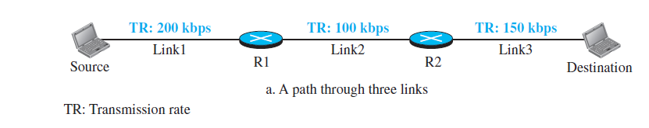
Throughput
Throughput = minimum {TR1, TR2, . . . TRn}.
Throughput is the number of messages successfully transmitted per unit time. It is controlled by available bandwidth, the available signal-to-noise ratio and hardware limitations. The maximum throughput of a network may be consequently higher than the actual throughput achieved in everyday consumption. The terms ‘throughput’ and ‘bandwidth’ are often thought of as the same, yet they are different. Bandwidth is the potential measurement of a link, whereas throughput is an actual measurement of how fast we can send data.

Slide 13
Example:
Input: A network with bandwidth of 10 Mbps can pass only an average of 12, 000 frames per minute where each frame carries an average of 10, 000 bits. What will be the throughput for this network?
Output: We can calculate the throughput as- Throughput = (12, 000 x 10, 000) / 60 = 2 Mbps The throughput is nearly equal to one-fifth of the bandwidth in this case.

Slide 14
Packet Loss
When a router receives a packet while processing another packet, the received packet needs to be stored in the input buffer waiting for its turn.
A router, however, has an input buffer with a limited size. A time may come when the buffer is full and the next packet needs to be dropped.
The effect of packet loss on the Internet network layer is that the packet needs to be resent, which in turn may create overflow and cause more packet loss.

